Slide 1

MODEL INSTITUTE OF ENGINEERING AND TECHNOLOGY(MIET),JAMMU
Department of Computer Engineering
Group Members:- 1) Sania Fotedar(2021a1r082)
[GROUP REPRESENTATIVE]
2)Madhu Bala(2021a1r077)
3)Amisha Gurndwal (2021a1r062)
4)Rachna Sharma(2021a1r078)
5)Arjun Kapoor (2021a1r061)
Project Guide: Dr. Swati Goel

Slide 2
Project Title : FILE ORGANIZATION TECHNIQUES

Slide 3
PROJECT DESCRIPTION
A) SINGLE LEVEL DIRECTORY:
AIM: Program to simulate Single level directory file organization technique.
DESCRIPTION: The directory structure is the organization of files into a hierarchy of folders. In a single-level directory system, all the files are placed in one directory. There is a root directory which has all files. It has a simple architecture and there are no sub directories. Advantage of single level directory system is that it is easy to find a file in the directory.
B) TWO LEVEL DIRECTORY
AIM: Program to simulate two level file organization technique
Description: In the two-level directory system, each user has own user file directory (UFD). The system maintains a master block that has one entry for each user. This master block contains the addresses of the directory of the users. When a user job starts or a user logs in, the system's master file directory (MFD) is searched. When a user refers to a particular file, only his own UFD is searched.

Slide 4
CONTENT:
FILE ORGANIZATION
DIRECTORY STRUCTURE
SINGLE LEVEL DIRECTORY
TWO LEVEL DIRECTORY
ALGORITHM
IMPLEMENTATION

Slide 5
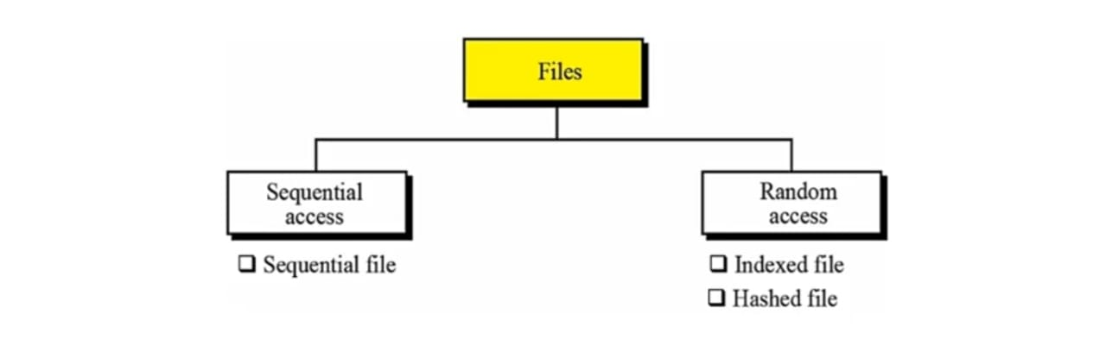
FILE ORGANIZATION
File organization refers to the manner in which the records of a file are arranged on secondary storage.

Slide 6
DIRECTORY STRUCTURE
Directory can be defined as the listing of the related files on the disk. The directory may store some or the entire file attributes.
To get the benefit of different file systems on the different operating systems, A hard disk can be divided into the number of partitions of different sizes. The partitions are also called volumes or mini disks.

Slide 7
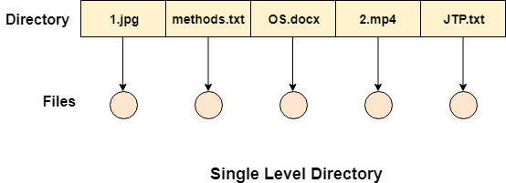
SINGLE LEVEL DIRECTORY
The simplest method is to have one big list of all the files on the disk. The entire system will contain only one directory which is supposed to mention all the files present in the file system. The directory contains one entry per each file present on the file system.

Slide 8
ADVANTAGES AND DISADVANTAGES
Advantages
Implementation is very simple.
If the sizes of the files are very small then the searching becomes faster.
File creation, searching, deletion is very simple since we have only one directory.
Disadvantages
We cannot have two files with the same name.
The directory may be very big therefore searching for a file may take so much time.
Protection cannot be implemented for multiple users.

Slide 9
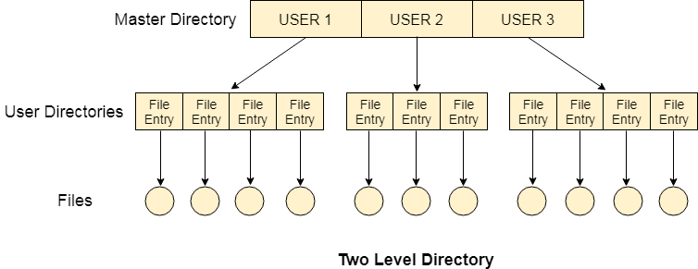
TWO LEVEL DIRECTORY
.
.
In two level directory systems, we can create a separate directory for each user. There is one master directory which contains separate directories dedicated to each user. For each user, there is a different directory present at the second level, containing group of user's file. The system doesn't let a user to enter in the other user's directory without permission.

Slide 10
ADVANTAGES AND DISADVANTAGES
Advantages:
We can give full path like /User-name/directory-name/.
Different users can have the same directory as well as the file name.
Searching of files becomes easier due to pathname and user-grouping.
Disadvantages:
A user is not allowed to share files with other users.
Still, it not very scalable, two files of the same type cannot be grouped together in the same user.

Slide 11
ALGORITHM OF SINGLE LEVEL DIRECTORY :
Step-1: Start the program.
Step-2: Declare the count, file name, graphical interface.
Step-3: Read the number of files
Step-4: Read the file name
Step-5: Declare the root directory
Step-6: Using the file eclipse function define the files in a single level
Step-7: Display the files
Step-8: Stop the program

Slide 12
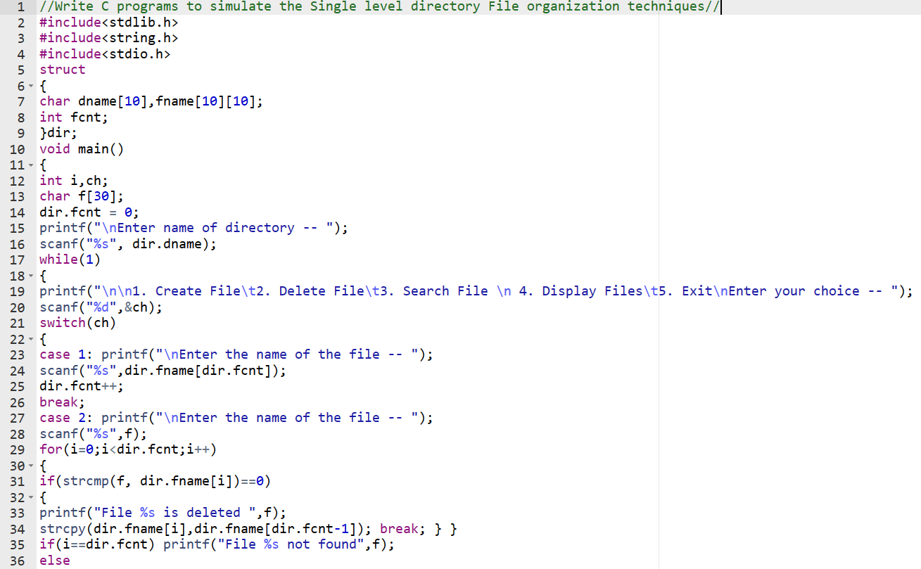
Program to Simulate Single level directory file organization technique

Slide 13
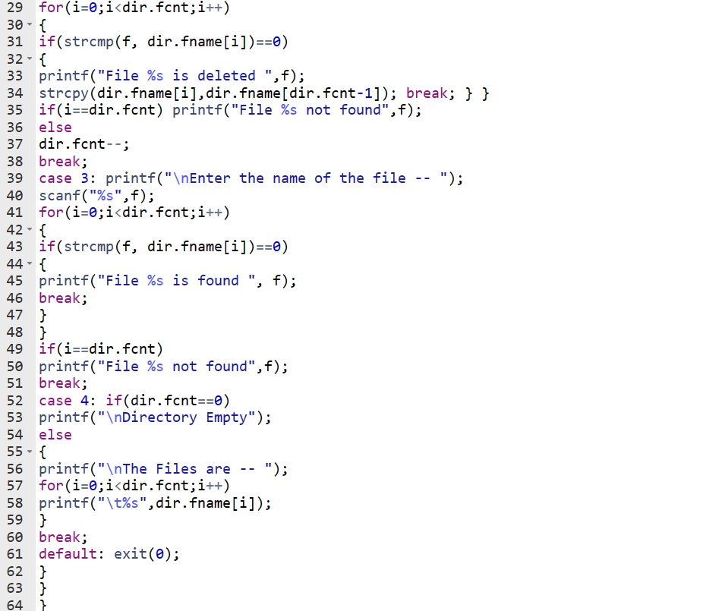

Slide 14
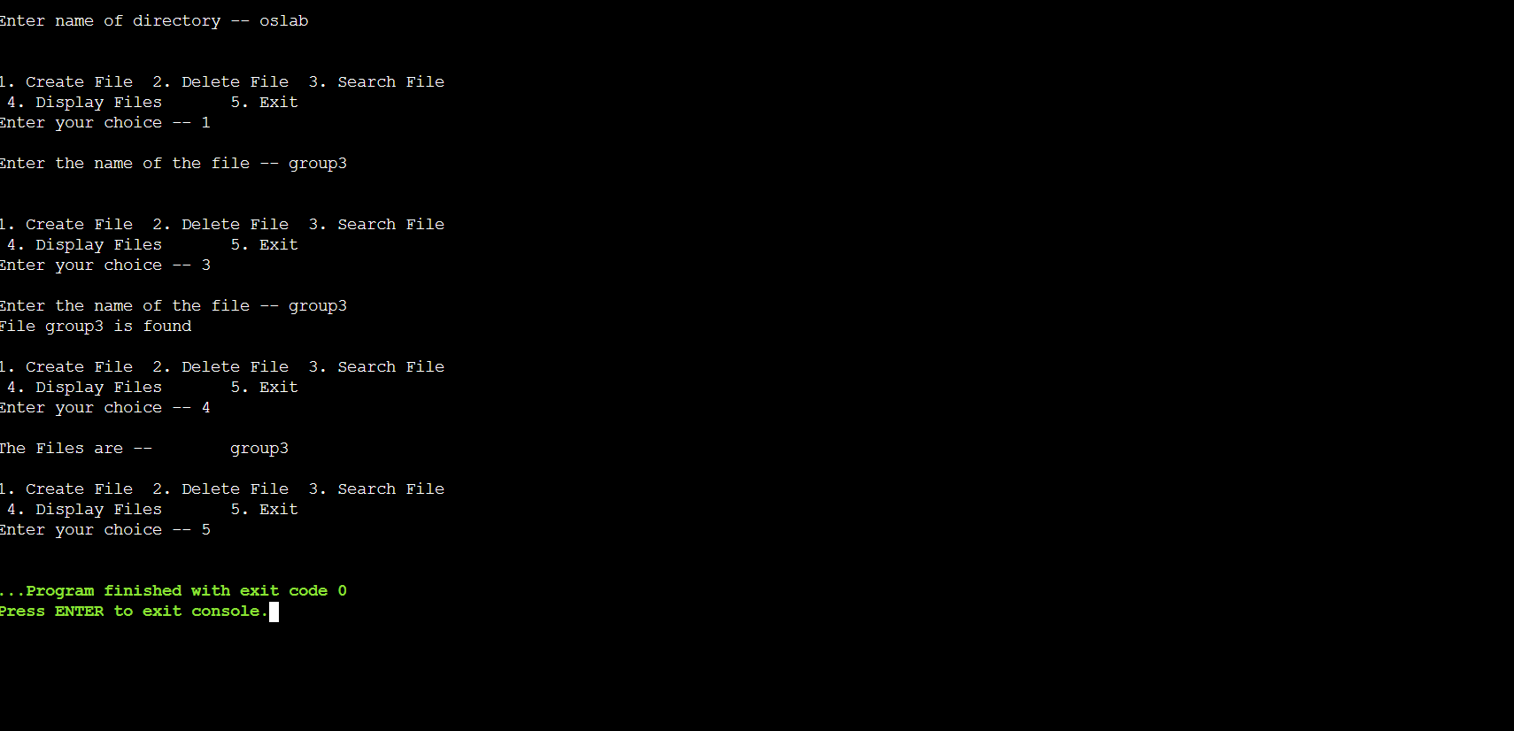
OUTPUT

Slide 15
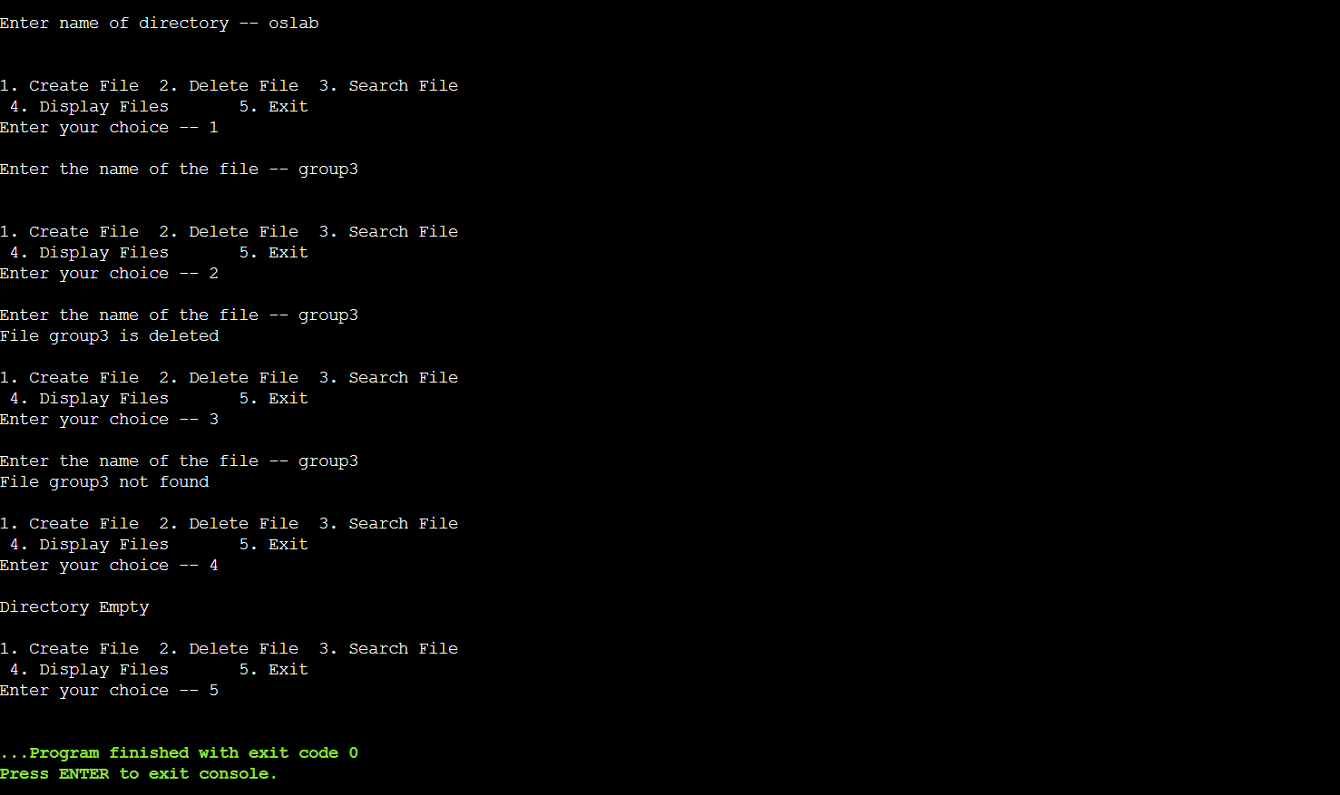

Slide 16
ALGORITHM OF TWO LEVEL DIRECTORY
Step-1: Start the program.
Step-2: Declare the count, file name, graphical interface.
Step-3: Read the number of files
Step-4: Read the file name
Step-5: Declare the root directory
Step-6: Using the file eclipse function define the files in a single level
Step-7: Display the files
Step-8: Stop the program

Slide 17
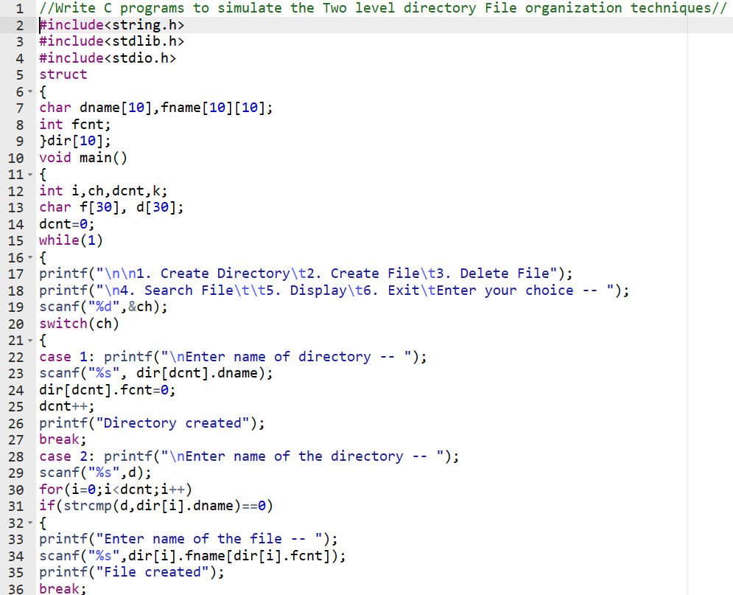
PROGRAM TO SIMULATE TWO LEVEL DIRECTORY FILE ORGANIZATION TECHNIQUES:

Slide 18
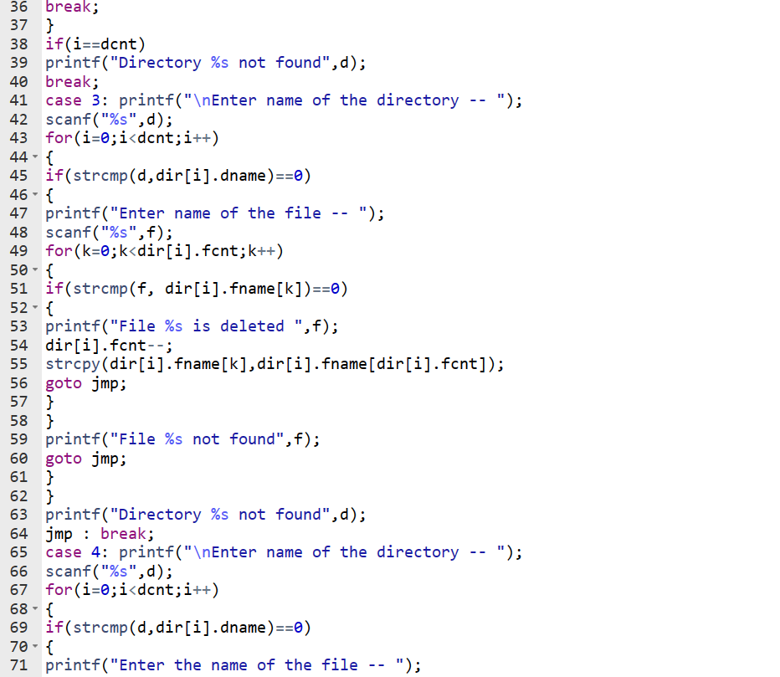

Slide 19
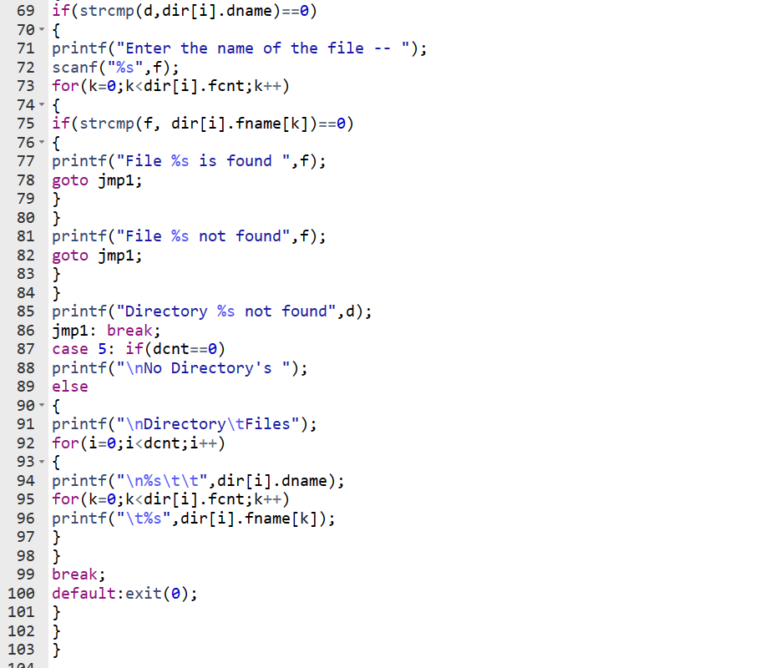

Slide 20


Slide 21
THANK YOU

